Slide 1
HIGH PERFORMANCE COMPUTING
Text Book :
Computer Architecture and Parallel Processing
by Kai Hwang and Faye A. Briggs

Slide 2
MODULE 1
CHAPTER 1:
INTRODUCTION TO PARALLEL PROCESSING

Slide 3
MODULE 1
Introduction to parallel processing - Trends towards parallel processing - Parallelism in uniprocessor – Parallel computer structures-Architecture classification schemes , Amdahl’s law,Indian contribution to parallel processing

Slide 4
INTRODUCTION TO PARALLEL COMPUTING
Parallel computing is a form of computation in which many calculations are carried out simultaneously,operating on the principle that large problems can often be divided into smaller ones, which are then solved concurrently ("in parallel").

Slide 5
Serial vs. Parallel computation
Serial Computation
To be run on a single computer having a single Central Processing Unit (CPU).
A problem is broken into a discrete series of instructions.
Instructions are executed one after another.
Only one instruction may execute at any moment in time.

Slide 6
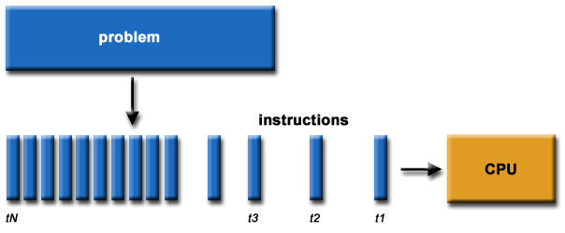

Slide 7
Parallel computing
A problem is broken into discrete parts that can be solved concurrently.
Each part is further broken down to a series of instructions.
Instructions from each part execute simultaneously on different CPUs.

Slide 8
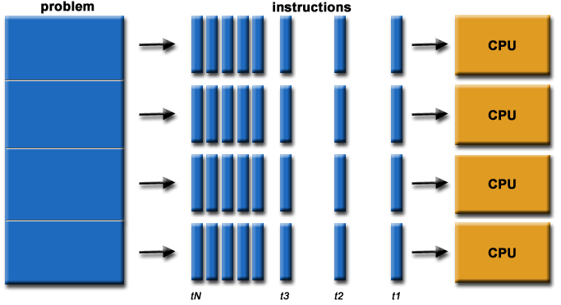

Slide 9
Why Use Parallel Computing?

Slide 10
Main Reasons:
Save time and/or money: Using more resources for a task will shorten its time to completion, with potential cost savings. Parallel clusters can be built from cheap, commodity components.
Solve larger problems: Many problems are so large and/or complex that it is impractical or impossible to solve them on a single computer, especially given limited computer memory.

Slide 11
Provide concurrency: A single compute resource can only do one thing at a time. Multiple computing resources can be doing many things simultaneously.
Use of non-local resources: Using compute resources on a wide area network, or even the Internet when local compute resources are scarce.
Overcoming Memory constraints: Single computers have a very finite memory resources. For large problems, using the memories of multiple computers may overcome this obstacle.

Slide 12
Different forms of parallel computing
Bit level parallelism
Instruction level parallelism
Data level parallelism
Task level parallelism

Slide 13
Bit-level parallelism is a form of parallel computing based on increasing processor word size. Increasing the word size reduces the number of instructions the processor must execute in order to perform an operation on variables whose sizes are greater than the length of the word.
(For example, consider a case where an 8-bit processor must add two 16-bit integers. The processor must first add the 8 lower-order bits from each integer, then add the 8 higher-order bits, requiring two instructions to complete a single operation. A 16-bit processor would be able to complete the operation with single instruction.

Slide 14
Data parallelism (also known as loop-level parallelism) is a form of parallelization of computing across multiple processors in parallel computing environments. Data parallelism focuses on distributing the data across different parallel computing nodes. Data parallelism is achieved when each processor performs the same task on different pieces of distributed data.

Slide 15
For instance, consider a 2-processor system (CPUs A and B) in a parallel environment, and we wish to do a task on some data d. It is possible to tell CPU A to do that task on one part of d and CPU B on another part simultaneously, thereby reducing the duration of the execution. The data can be assigned using conditional statements .
As a specific example, consider adding two matrices. In a data parallel implementation, CPU A could add all elements from the top half of the matrices, while CPU B could add all elements from the bottom half of the matrices. Since the two processors work in parallel, the job of performing matrix addition would take one half the time of performing the same operation in serial using one CPU alone.
if CPU = "a"
lower_limit := 1
upper_limit := round(d.length/2)
else if CPU = "b"
lower_limit := round(d.length/2) + 1
upper_limit := d.length

Slide 16
Instruction-level parallelism (ILP) is a measure of how many of the operations in a computer program can be performed simultaneously.
Consider the following program:
e = a + b
f = c + d
m = e * f
Operation 3 depends on the results of operations 1 and 2, so it cannot be calculated until both of them are completed.
However, operations 1 and 2 do not depend on any other operation, so they can be calculated simultaneously.
If we assume that each operation can be completed in one unit of time then these three instructions can be completed in a total of two units of time, giving an ILP of 3/2.

Slide 17
Task parallelism (also known as function parallelism and control parallelism) is a form of parallelization of computer code across multiple processors in parallel computing environments.
As a simple example, if we are running code on a 2-processor system (CPUs "a" & "b") in a parallel environment and we wish to do tasks "A" and "B", it is possible to tell CPU "a" to do task "A" and CPU "b" to do task 'B" simultaneously, thereby reducing the run time of the execution.

Slide 18
Generation of Computer Systems
The division of computer system into generations is determined by
  Device technology
  System architecture
  Processing mode
  Language used
Time span of each generation is about 10 years

Slide 19
Early Electronic Computers and The Computer Generations
The First Generation (1951 to 1959)
Grace
Hopper
J. Presper Eckert
Clifford Berry
John Atanasoff
Howard Aiken
John von Neumann
John Mauchly
Notes:
3

Slide 20
First Generation Computers
1951-1959
Characterized by vacuum tubes which burned out very rapidly.
The first generation of computers used machine language or 0s and 1s.
This generation also used magnetic tape.

Slide 21
The First Generation (1951 to 1959)
Early Electronic Computers
  Atanasoff and Berry develop the ABC--first special purpose, electronic digital computer (1939)
  Aiken and IBM completed Mark I computer in 1944
  Mauchly and Eckert developed ENIAC (completed 1945)
John von Neumann--stored-program concept
The First Generation (1951 to 1959)
  - Used vacuum tubes
  - Programmed by machine language
  - IBM announced first commercial computer, the IBM 701, in 1953
  - Used punched cards for data and instructions
  - Magnetic tape introduced in 1957

Slide 22
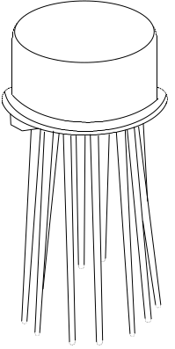



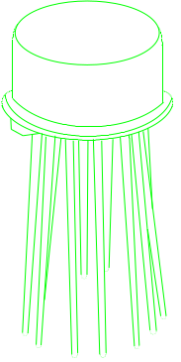

The Second Generation (1959 to 1963)
Computer Generations
Notes:
4
The Computer Generations (Continued)
The Second Generation (1959 to 1963)
- Used transistors
- Memory composed of small magnetic cores (See illustration in
book)
- Magnetic disks and magnetic tape used for secondary storage
- Communications possible
- New concepts
Multiprogramming
Parallel processing
- Input and output devices very slow

Slide 23
Second Generation
1959-1963
The second generation of computers used transistors for the internal operations.
They used magnetic core for the memory.
These machines used assembly language.

Slide 24
The Second Generation (1959 to 1963)
Used transistors
Memory composed of small magnetic cores
Magnetic disks and magnetic tape used for secondary storage
Communications possible
New concepts
  Multiprogramming
  Parallel processing
Input and output devices very slow

Slide 25

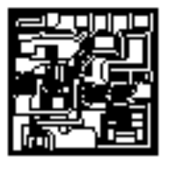

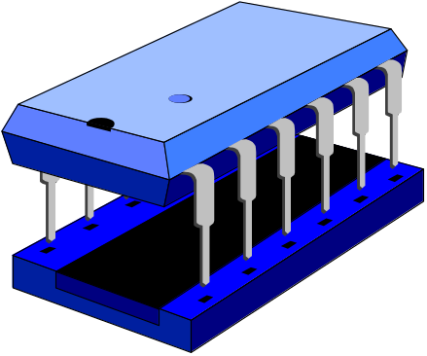
The Third Generation (1963 to 1975)
Robert Noyce
Jack St.. Clair Kilby
Notes:
5
The Computer Generations (Continued)
The Third Generation (1963 to 1975)
- First integrated circuit
- Produced on wafers
- Silicon Valley
- DEC announces a computer based on integrated circuits
PDP-8
Time-sharing

Slide 26
Third Generation
1963-1975
These computers used integrated circuits on silicon chips.
They were characterized with high-level programming languages which required logic such as BASIC, Pascal, C, COBOL, and Fortran

Slide 27
The Third Generation (1963 to 1975)
First integrated circuit
Produced on wafers
Silicon Valley
DEC announces a computer based on integrated circuits
PDP-8
Time-sharing

Slide 28

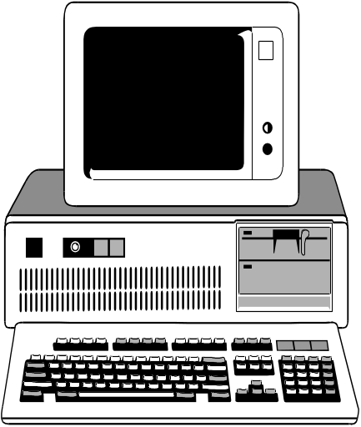
The Fourth Generation (1975 to 1991)
Notes:
6

Slide 29
Fourth Generation
1975-1991
These computers use microprocessor chips.
Object-Oriented Programming (OOP) Languages such as Visual Basic, and JAVA are characteristic of this computer generation.

Slide 30
The Fourth Generation (1975 to 1991)
Dr. Ted Hoff creates the world’s first microprocessor
Intel 4004
Used VLSI (very-large-scale-integration)
- Development of Intel 8080 chip -- used in the Altair
- Jobs and Wozniak
Apple Computer, Inc. in April, 1977
Apple I and Apple II
- VisiCalc introduced in 1979
- IBM contracts with Microsoft to write OS in 1980
First IBM PC released in 1981
- Pentium microprocessor
- LANs and WANs
- GUI

Slide 31

Fifth Generation(1991 TO TODAY)
AI and Natural Languages
Computer Generations
Notes:
7
The Computer Generations (Continued)
A Fifth Generation
Artificial Intelligence--capabilities to decode and respond to natural language, to reason and draw references, and to organize patterns in sensory input

Slide 32
A Fifth Generation
  Artificial Intelligence--capabilities to decode and respond to natural language, to reason and draw references, and to organize patterns in sensory input

Slide 33
5th Generation
Still Being Developed
Natural Language
This language is designed to give people a more human connection with computers.
Uses multi-media has also defined this generation.
There is a great deal of “bundled software” with this generation.

Slide 34
Trends Towards Parallel processing
In application point of view growth of Processing cycle is in Four levels:
Data processing
Information processing
Knowledge processing
Intelligence processing

Slide 35
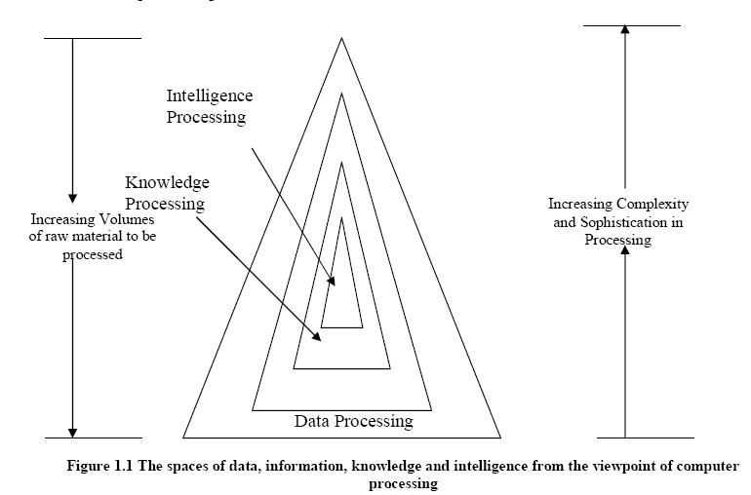
Information Processing

Slide 36
♦ Data are symbolic depictions of facts. Data objects are considered mutually unrelated in the space.
♦ Information is data set in particular context. i.e. Collection of data objects that are related by some syntactic structure.
♦ Knowledge is the product of thinking, the connection of information in a logical-functional way. Knowledge allows us to explain or give reasons for phenomena.
♦ Intelligence is the processes and the products that lead to understanding and taking decisions related to reality.

Slide 37
Computer usage started with data processing, while is still a major task of today’s computers.
With more and more data structures developed, many users are shifting to computer roles from pure data processing to information processing.
A high degree of parallelism has been found at these levels.
As the accumulated knowledge bases expanded rapidly in recent years, there grew a strong demand to use computers for knowledge processing.
Intelligence is very difficult to create; its processing even more so.

Slide 38
In operating point of view, computer systems are in four phases:
Batch processing
Multiprogramming
Time sharing
Multiprocessing
In these four operating modes, the degree of parallelism increases sharply from phase to phase.

Slide 39
Batch Processing: Jobs that can run without end user interaction, or can be scheduled to run as resources permit, are called batch jobs. Batch processing is for those frequently used programs that can be executed with minimal human interaction.
A program that reads a large file and generates a report, for example, is considered to be a batch job.

Slide 40
Multiprogramming : Multiprogramming is a rudimentary form of parallel processing in which several programs are run at the same time on a uniprocessor. Since there is only one processor, there can be no true simultaneous execution of different programs. Instead, the operating system executes part of one program, then part of another, and so on. To the user it appears that all programs are executing at the same time.
In Time shared systems, the running task is required to relinquish the CPU, either voluntarily or by an external event such as a hardware interrupt.

Slide 41
Multiprocessing: Multiprocessing is running a system with more than one processor. The performance can be doubled by using two processors instead of one.

Slide 42
Parallel processing can be challenged in four programmatic levels:
  Job or program level
  Task or procedure level
  Inter instruction level
  Intra instruction level
The highest job level is often conducted algorithmically.
The lowest intra-instruction level is often implemented directly by hardware means.
Hardware roles increase from high to low levels.
On the other hand, software implementations increase from low to high levels.

Slide 43
Features of Parallel Processing
Better Quality of solution : When arithmetic operations are distributed among many computers, each one does a similar number of arithmetic operations. Thus rounding error are lower when parallel computers are used.
Better algorithms: The availability of many computers which can work simultaneously leads to different algorithms which are not relevant for purely sequential computers. It is possible to explore different facets of a solution simultaneously using several processors and these give better insight to solutions of several physical problem.
Greater Reliability: Fault tolerant systems.

Slide 44
Parallelism in Uniprocessor Systems
A system with single processor is called uniprocessor system. Uniprocessor system consists of three major components:
the main memory
the Central processing unit (CPU)
the Input-output (I/O) sub-system.
Example:
Supermini VAX-11/780 uniprocessor system
Mainframe IBM System 370/Model 168 uniprocessor system

Slide 45
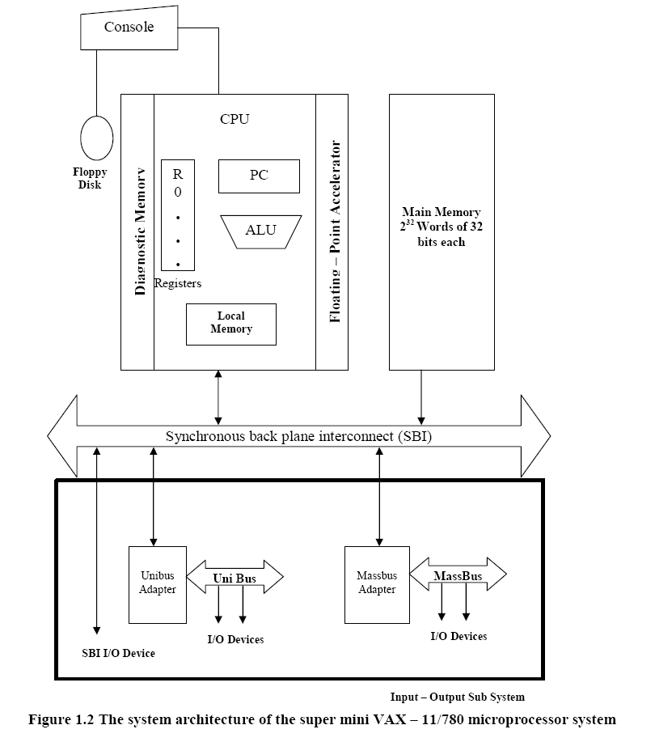

Slide 46
There are sixteen 32-bit general purpose registers, one of which serves as the program Counter (pc).
There is also a special CPU status register containing information about the current state of the processor and of the program being executed.
The CPU contains an arithmetic and logic unit (ALU) with an optional floating-point accelerator, and some local cache memory with an optional diagnostic memory.

Slide 47
The CPU can be intervened by the operator through the console connected to a floppy disk.
The CPU, the main memory and the I/O subsystems are all connected to a common bus, the synchronous backplane interconnect (SBI).
Through this bus, all I/O devices can be communicate with each other, with the CPU, or with the memory.
Peripheral storage or I/O devices can be connected directly to the SBI through the unibus and its controller or through a mass bus and its controller.

Slide 48
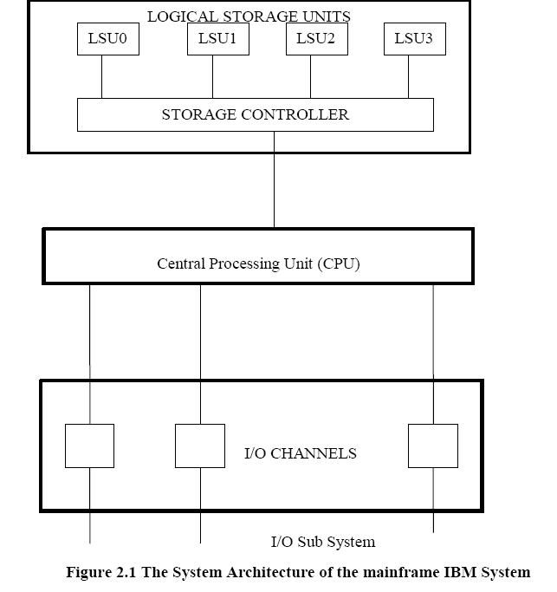

Slide 49
The system architecture of the mainframe IBM System 370/168 uniprocesor computer consists of three major components:
The main memory
Its divided into four units, referred as Logical Storage Units (LSU) and that are four way interleaved.
The storage controller provides multiport connections between CPU and four LSUs.
The Central Processing Unit
The CPU contains the instruction decoding and execution units as well as a cache.
The input/output subsystems
Peripherals are connected to the system via high speed I/O channels which operate asynchronously with the CPU.

Slide 50
Parallel Processing Mechanisms
Multiplicity of Functional units
Parallelism and Pipelining within the CPU
Overlapped CPU and I/O operations
Use of a hierarchical memory system
Multiprogramming and time sharing
Balancing of subsystem bandwidth

Slide 51
Parallel Processing Mechanism
A number of parallel processing mechanisms have been developed in uniprocessor computers.
We identify them in the following six categories:
  multiplicity of functional units
  parallelism and pipelining within the CPU
  overlapped CPU and I/O operations
  use of a hierarchical memory system
  multiprogramming and time sharing
  multiplicity of functional units

Slide 52
1.Multiplicity of Functional units
The technique of employing multiple functional units in a single processor is called ‘Superscalar architecture’, meaning multiple instructions of a single program are simultaneously started and processed in parallel, in different functional units.

Slide 53
Example : CDC-6600 computer
The CDC-6600 is an example of high performance computer with multiple functional units. It is known as network computer since it has a special organization with one central processor which consists of 10 functional units and 10 peripherals and control processors. The 10 functional units within the central processor are as follows:
One fixed point adders
Two multipliers
One divider
Two incrementers
One floating point adder
One shifter
One logical unit
One branch unit

Slide 54
System Architecture of CDC-6600 computer
I/O subsystems
Memory
Central processor
Central
Storage
Peripheral processors
10 functional
units
Add
PP0
Multiply
PP1
PP2
Multiply
PP3
24
registers
Divide
10
Peripheral
channels
PP4
PP5
Fixed add
PP6
Increment
PP7
PP8
increment
PP9
Boolean
Instruction
stack
Shift
Branch
Scoreboard

Slide 55
The CPU has 24 useful registers
Eight index registers
Eight operand address registers
Eight floating point registers
-The control unit takes care of routing the instruction to functional units.
-10 functional units along with the scoreboard that provides a queue and reservation scheme. (A scoreboard is used to keep track of the availability of the functional units and registers being demanded.)

Slide 56
2. Parallelism And Pipelining Within the CPU
The first generation machines had the bit-serial adder. But now almost all ALUs are making use of parallel adders such as carry-look ahead adders and carry-save adders.
Various phases of instructions executions are now pipelined, including instruction fetch, decode, operand fetch, arithmetic logic execution, and store result.
To facilitate overlapped instruction executions through pipe, instruction prefetch and data buffering techniques have been developed.

Slide 57
3.Overlapped CPU and I/O Operations
I/O operations can be performed simultaneously with the CPU computations by using separate I/O controllers, channels, or I/O processors.
The direct memory access (DMA) channel can be used to provide direct information transfer between the I/O devices and the main memory.
The DMA is conducted on a cycle stealing basis, which is apparent to the CPU.
I/O multiprocessing can speed up data transfer b/w the CPU.

Slide 58
4. Use of hierarchical memory system
Though the CPU is 1000 times faster than memory access a hierarchical memory system can be used to close up the speed gap.

Slide 59
CPU
Registers
Cache
Increasing in
capacity
Main memory
(RAMs or core)
Increasing in
speed
Fixed-head disks, drum, charge-coupled
devices, or magnetic bubble memory
Moving head disks
Magnetic tape units
The classical memory hierarchy

Slide 60
The inner most level is the register files directly addressable by ALU.
Cache memory can be used to serve as a buffer between the CPU and the main memory.
Block access of the main memory can be achieved through multiway interleaving across parallel memory modules.
Virtual memory space can be established with the use of disks and tapes at the outer levels.

Slide 61
5.Multiprogramming
Within the same interval of time, there may be multiple processes active in a computer, competing for memory, I/O and CPU resources.
The program interleaving is intended to promote better remote utilization through overlapping I/O and CPU operations.
Whenever a process P1 is tied up with I/O processor for performing input output operation at the same moment CPU can be tied up with an process P2. This allows simultaneous execution of programs. The interleaving of CPU and I/O operations among several programs is called as Multiprogramming.

Slide 62
6. TIMESHARING
Time sharing was first developed for a uniprocessor system.
Multiprogramming on uniprocessor is centered around the sharing of CPU by many programs. Sometimes high priority programs may occupy the CPU for long time and other programs are put up in queue. This problem can be overcome by a concept called as Time sharing in which every process is allotted a time slice of CPU time and thereafter after its respective time slice is over CPU is allotted to the next program if the process is not completed it will be in queue waiting for the second chance to receive the CPU time.

Slide 63
7. Balancing Of Subsystem Bandwidth
The bandwidth of a system is defined as the number of operations performed per unit time.
CPU is the fastest unit in a computer, with a processor cycle t_{p} of tens of nanoseconds; the main memory has a cycle time t_{m} of hundreds of nanoseconds; and the i/o devices are the slowest with an average access time t_{d} of a few milliseconds, then t_{d} > t_{m} > t_{p} .
In case of main memory the memory bandwidth is measured by the number of words that can be accessed per unit time. Let W be the number of words delivered per memory cycle t_{m} ,then the maximum memory bandwidth B_{m} is equal to B_{m}= W/ t_{m} .
Memory bandwidth affects the CPU performance because CPU speed is limited by the rate at which it can fetch instructions from its cache or main memory.

Slide 64
Bandwidth Balancing Between CPU and Memory
The speed gap between the CPU and the main memory can be closed up by using fast cache memory between them.
A block of memory words is moved from the main memory into the cache so that immediate instructions can be available most of the time from the cache.

Slide 65
Bandwidth Balancing Between Memory and I/O Devices
Input-output channels with different speeds can be used between the slow I/O devices and the main memory.
The I/O channels perform buffering and multiplexing functions to transfer the data from multiple disks into the main memory by stealing cycles from the CPU.

Slide 66
Parallel Computer Structures
Parallel computers are those systems that emphasize parallel processing. Parallel computers are divided into three architectural configurations:
    Pipeline computers
    Array processors
    Multiprocessors

Slide 67
A pipeline computer performs overlapped computations to exploit temporal parallelism. In a non pipelined computer execution must be completed before the next instructions can be issued.
An array processor is a synchronous parallel computer with multiple synchronized arithmetic logic units called processing elements (PE) to achieve spatial parallelism. The PEs are synchronized to perform the same function at the same time.
A basic multiprocessor contains two or more processors of comparable capabilities. All processors share access to common sets of memory modules, I/O channels and peripheral devices.

Slide 68
Pipeline Computers
In computing pipeline is a set of data processing elements connected in series, so that output of one element is the input to the next one.
The elements of a pipeline are often executed in parallel or in time sliced fashion, in that case, some amount of buffer storage is often inserted between elements.
The process of executing an instruction in a digital computer involves 4 major steps namely Instruction fetch, Instruction decoding, Operand fetch, Execution. In a pipelined computer successive instructions are executed in an overlapped fashion.

Slide 69
Instruction fetch : Instruction is fetched from the main memory
Instruction decoding: Identifying the operation to be performed.
Operand Fetch: If any operands needed, is fetched.
Execution : Execution of the Arithmetic and logical operation

Slide 70
An instruction cycle consists of multiple pipeline cycles. The flow of data (input operands, intermediate results and output results) from stage to stage is triggered by a common clock of the pipeline. The operations of all stages are triggered by a common clock of the pipeline.
For a pipelined computer, it takes four pipeline cycles to complete one instruction. Once a pipeline is filled up, an output result is produced from the pipeline on each cycle.
The instruction cycle has been effectively reduced to 1/4th of the original cycle time by such overlapped execution.

Slide 71
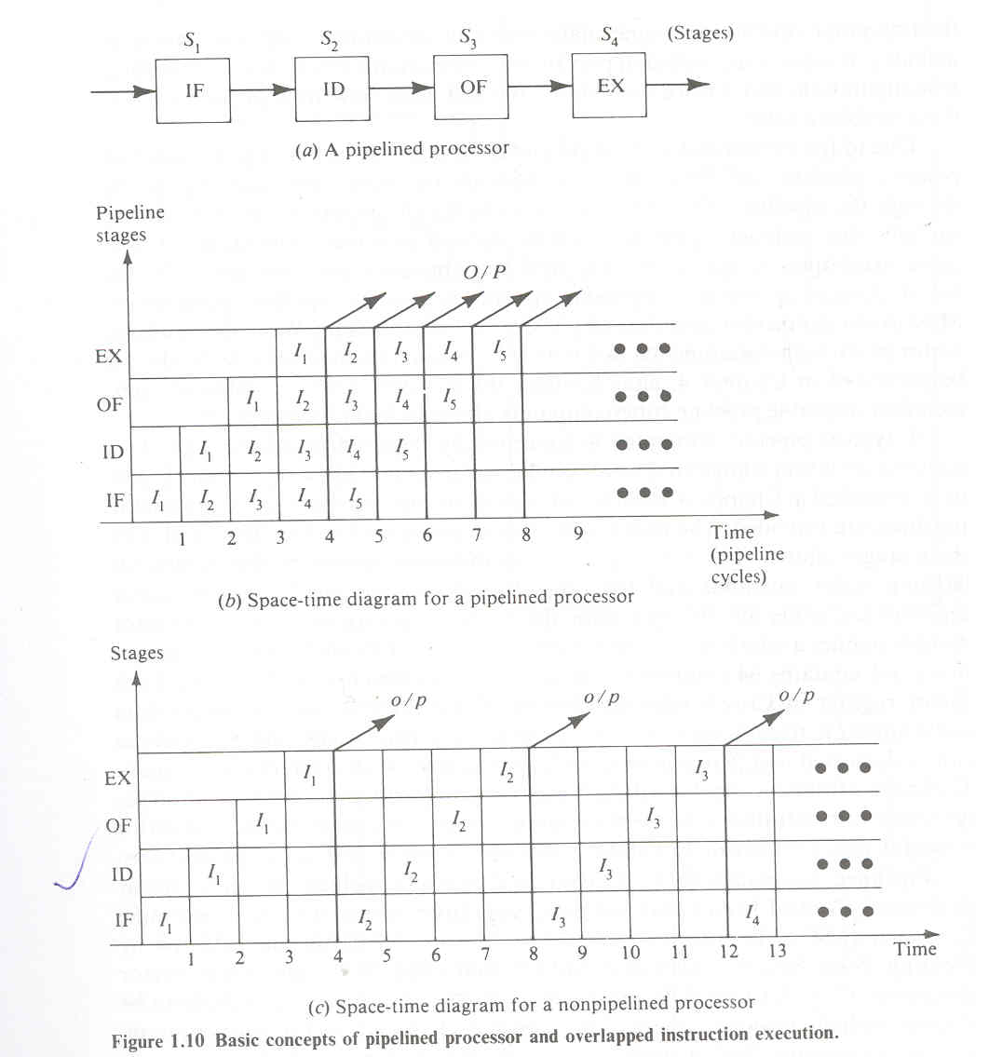
S1
S2
S3
S4
IF
ID
OF
EX
A Pipelined processor

Slide 72
Scalar processors
Main
Memory
Scalar data
SP1
Scalar
registers
SP2
K
K
SPn
Scalar
fetch
scalar pipelines
I/O
IS
Instruction
fetch
(IF)
Instruction
decode
(ID)
(OF)
K
vector processors
VP1
Vector
fetch
Vector
registers
VP2
Instruction Preprocessing
K
VPn
Vector data
Vector pipelines
Functional structure of a pipeline computer with scalar and vector capabiliites

Slide 73
Array Processors
An array processor is a synchronous parallel computer with multiple arithmetic logic units called processing elements (PE) that can operate in parallel in lock step fashion.
By replication one can achieve spatial parallelism. The PEs are synchronized to perform the same function at the same time. An appropriate data-routing mechanism must be established among the PEs.
Scalar and control type of instructions are directly executed in the control unit (CU).
Each PE consists of an ALU registers and a local memory. Vector instructions are broadcasted to the PEs for distributed execution over different component operands fetched directly from local memories. .
Array processors are much more difficult to program than pipeline machines.

Slide 74
I/O
CP
Control unit
(scalar processing
CM
Data bus
PE1
PE2
PEn
Control
P
P
P
M
M
M
Array processing
Inter-PE connection network
(data routing)
Functional structure of an SIMD array processor

Slide 75
Multiprocessor Systems
A basic multiprocessor system contains two or more processors of comparable capabilities.
All processors share access to common sets of memory modules, I/O channels and peripheral devices.
The entire system must be controlled by a single integrated operating system providing interactions between processors and their programs at various levels.
Besides shared memories and i/o devices, each processor has its own local memory.

Slide 76
- Multiprocessor hardware system organization is determined by the interconnection structure to be used between the memories and processors.
- Three different interconnection are
Time shared Common bus
Cross Bar switch network
Multiport memories

Slide 77
I/O channels
MM1
Input output
interconnection
n/w
Interprocessor memory
connection
n/w
MM2
MMm
Shared memory
P1
LM1
Interprocessor
interrupt
n/w
P2
LM2
Functional design of MIMD multiprocessor system

Slide 78
Architectural Classification Schemes
Three computer architectural classifications :
Flynn’s Classification, based on multiplicity of instruction stream and data stream.
Feng’s Classification, serial versus parallel processing.
Handler’s Classification, is determined by degree of parallelism and pipelining in various subsystem levels.

Slide 79
Flynn's classification
Flynn's classification scheme is based on the notion of a stream of information.
Two types of information flow into a processor: instructions and data.
The instruction stream is defined as the sequence of instructions performed by the processing unit. The data stream is defined as the data traffic exchanged between the memory and the processing unit.
Computer architecture can be classified into the following four distinct categories:
    single-instruction single-data streams (SISD).
    single-instruction multiple-data streams (SIMD).
    multiple-instruction single-data streams (MISD).
    multiple-instruction multiple-data streams (MIMD).

Slide 80
Both instructions and data are fetched from the memory modules.
Instructions are decoded by control unit, which sends the decoded instruction stream to the processor units for the execution.
Data streams flow between processors and memory subsystem.
Each instruction stream is generated by an independent control unit. Multiple data streams originate from the subsystem of shared memory module.

Slide 81
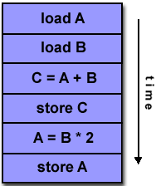
SISD computer organization
A serial (non-parallel) computer.
Instructions are executed sequentially but may be overlapped in their execution stages (pipelining).
Most SISD uniprocessor systems are pipelined.
An SISD computer may have more than one functional unit in it.
All the functional units are under the supervision of one control unit.

Slide 82
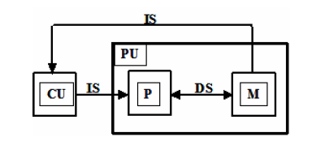

Slide 83
SIMD computer organization
A type of parallel computer.
Single instruction: All processing units execute the same instruction at any given clock cycle.
Multiple data: Each processing unit can operate on a different data element.
This type of machine typically has an instruction dispatcher, a very high-bandwidth internal network, and a very large array of very small-capacity instruction units.
Best suited for specialized problems characterized by a high degree of regularity, such as image processing.
Synchronous (lockstep) execution.
SIMD machines further divided into word-slice processing & bit-slice processing.

Slide 84
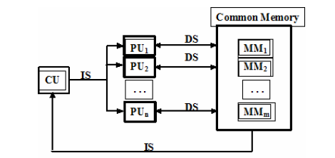
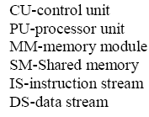

Slide 85
MISD computer organization
There are n processor units, each receiving distinct instructions operating over the same data streams and its derivatives. The output of one processor become input of the other in the macro pipe.
A single data stream is fed into multiple processing units.
Each processing unit operates on the data independently via independent instruction streams.

Slide 86
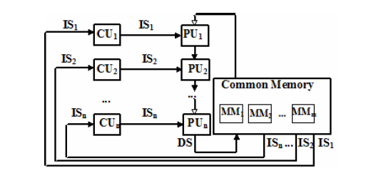

Slide 87
MIMD computer organization
Multiple-instruction multiple-data streams (MIMD) parallel architectures are made of multiple processors and multiple memory modules connected together via some interconnection network.
They fall into two broad categories: shared memory or message passing. Processors exchange information through their central shared memory in shared memory systems, and exchange information through their interconnection network in message passing systems.

Slide 88
Most processor systems and multiple computer systems can be classified in this category.
An intrinsic MIMD computer implies interaction among N processor because all memory streams are derived from the same data space shared by all processors.
An intrinsic MIMD computer is tightly coupled if the degree of interactions among the processors is high, otherwise loosely coupled.

Slide 89
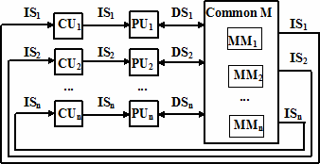

Slide 90
Feng’s Classification
Tse-yun Feng suggested the use of degree of parallelism to classify various computer architectures.
The maximum number of binary digits that can be processed within a unit time by a computer system is called the maximum parallelism degree P.
Let Pi be the number of bits that can be processed within the i^{th} processor cycle, T is processor cycle, then average parallelism degree, Pa=∑Pi/T.

Slide 91
Serial Versus Parallel Processing of binary
A bit slice is a string of bits one from each of the words at the same vertical position.
The maximum parallelism degree P(C) of a given computer system C is represented by the product of word length n and the bit-slice length m, i.e.P(C)=n.m
There are 4 types of methods under above classification
• Word Serial and Bit Serial (WSBS)
• Word Parallel and Bit Serial (WPBS)
• Word Serial and Bit Parallel (WSBP)
• Word Parallel and Bit Parallel (WPBP)

Slide 92
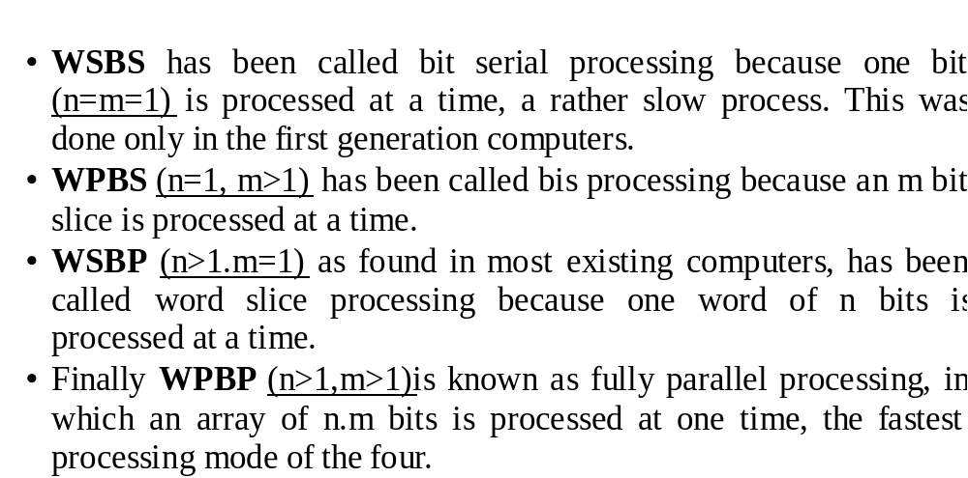

Slide 93
Handler’s Classification
Wolfgang Handler has proposed a classification scheme for identifying the parallelism degree and pipelining degree built into the hardware structure of a computer system.

Slide 94
Parallelism Versus Pipelining
Three subsystem levels:
• Processor Control Unit (PCU)
• Arithmetic Logic Unit (ALU)
• Bit Level Circuit (BLC)
Each PCU corresponds to one processor or one CPU. The ALU is equivalent to Processor Element (PE). The BLC corresponds to combinational logic circuitry needed to perform one bit operations in the ALU.

Slide 95
A computer system C can be characterized by a triple containing six independent entities
T(C) = <K x K', D x D', W x W' >
Where,
K = the number of processors (PCUs) within the computer
D = the number of ALUs under the control of one CPU
W = the word length of an ALU or of an PE
W' = The number of pipeline stages in all ALUs or in a PE
D' = the number of ALUs that can be pipelined
K' = the number of PCUs that can be pipelined

Slide 96
Ex : TI-ASC(Texax Instrument's Advanced Scientific Computer) has one controller controlling 4 aritmetic pipelines,each having 64 bit word length & 8 stages .
T(ASC) = < 1x1, 4x1, 64x8>

Slide 97
Parallel Processing Applications
Fast and efficient computers are in high demand in many scientific, engineering, energy resource, medical, military, AI, and basic research areas.
Parallel processing computers are needed to meet these demands.
Large scale scientific problem solving involves three interactive disciplines;
• Theories
• Experiments
• Computations

Slide 98
Theoretical scientists develop mathematical models that computer engineers solve numerically, the numerical results then suggest new theories.
Experimental science provides data for computational science and the latter can model processes that are hard to approach in the laboratory.

Slide 99
Computer Simulation has several advantages:
It is far cheaper and faster than physical experiments
It can solve much wider range of problems that specific laboratory equipments can.
Computational approaches are only limited by computer speed and memory capacity, while physical experiments have many special practical constraints.

Slide 100
Predictive Modeling and Simulations
Numerical Weather Forecasting
Socioeconomics and Government Use
Oceanography and Astrophysics

Slide 101
Engineering Design and Automation
Finite Element Analysis
Computational Aerodynamics
Artificial Intelligence and Automation
Remote Sensing Applications

Slide 102
Energy Resources Exploration
Seismic Exploration
Reservoir Modeling
Plasma Fusion Power
Nuclear Reactor Safety

Slide 103
Medical, Military and Basic research
Computer Aided Tomography
Genetic Engineering
Weapon Research and Defense
Basic Research Problem

Slide 104
Amdahl’s law

Slide 105
AMDAHL’S LAW
Amdahl's law, also known as Amdahl's argument, is used to find the maximum expected improvement to an overall system when only part of the system is improved.
It is often used in parallel computing to predict the theoretical maximum speedup using multiple processors.
Amdahl's Law is a law governing the speedup of using parallel processors on a problem, versus using only one serial processor.

Slide 106
AMDAHL’S LAW
Amdahl's Law states that potential program speedup is defined by the fraction of code (P) that can be parallelized:
speedup =1/(1 – P)
If none of the code can be parallelized, P = 0 and the speedup = 1 (no speedup).
If all of the code is parallelized, P = 1 and the speedup is infinite (in theory).
If 50% of the code can be parallelized, maximum speedup = 2, meaning the code will run twice as fast.
Introducing the number of processors performing the parallel fraction of work, the relationship can be modeled by:
speedup =1/((P/N) + S )
where P = parallel fraction, N = number of processors and S = serial fraction.

Slide 107
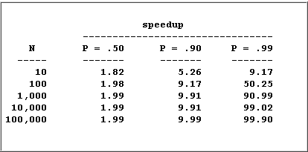
AMDAHL’S LAW
It soon becomes obvious that there are limits to the scalability of parallelism. For example:

Slide 108
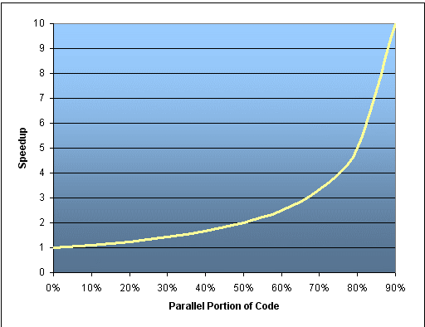


Slide 109
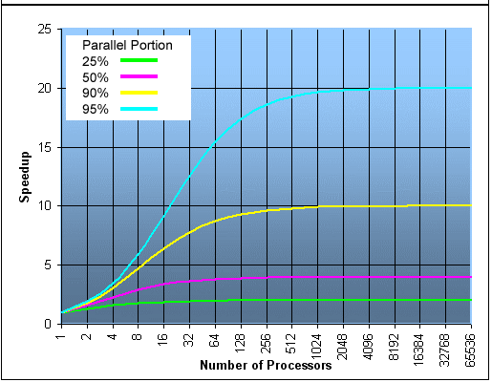

Slide 110
AMDAHL’S LAW
However, certain problems demonstrate increased performance by increasing the problem size. For example:
2D Grid Calculations 85 seconds 85%
Serial fraction 15 seconds 15%
We can increase the problem size by doubling the grid dimensions and halving the time step. This results in four times the number of grid points and twice the number of time steps.
The timings then look like:
2D Grid Calculations 680 seconds 97.84%
Serial fraction 15 seconds 2.16%
Problems that increase the percentage of parallel time with their size are more scalable than problems with a fixed percentage of parallel time.

Slide 111
Indian contribution to parallel processing

